Slide 1
IEC 61850 Data Modelling for Utilities
PAC World Americas Conference 2020
Jörg Reuter, Helinks LLC, Giuseppe Rigadello Enyr SRL 1.09.2020
jr@helinks.com, giuseppe.rigadello@enyr.eu

Slide 2
IEC 61850 Data Modeling for Utilities
What is an IEC 61850 Data Model?
Why Utilities care about IEC 61850 Data Modeling ?
How to create an IEC 61850 Data Model?
Conclusion!

Slide 3
Reminder :Content of SCL Files
Substation
IED
IED
Section
Process or Substation
Section
Voltage Level
Logical Device
Bay
Logical Node (LN)
Function
Logical Node (LNode)
Communication Configuration
Data Type
Templates
Section
Logical Node Type
SubNet
Communication
Section
Data Object Type
Network(s)
IED AP
IED AP
Data Attribute Type
IP Address Params
Communication Params
Enum Type

Slide 4
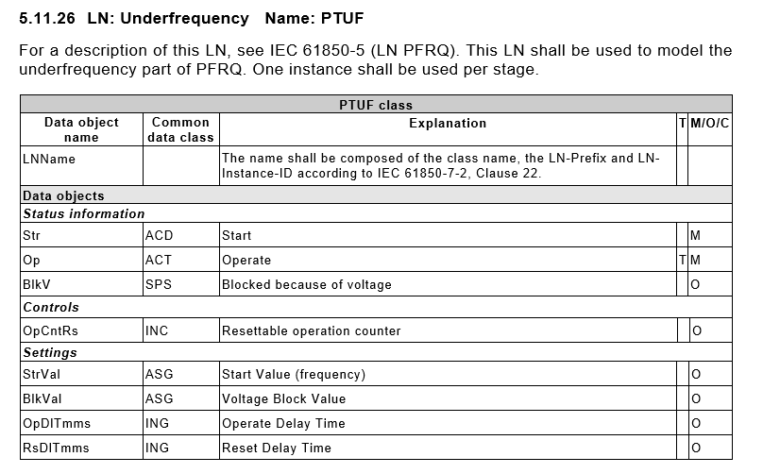
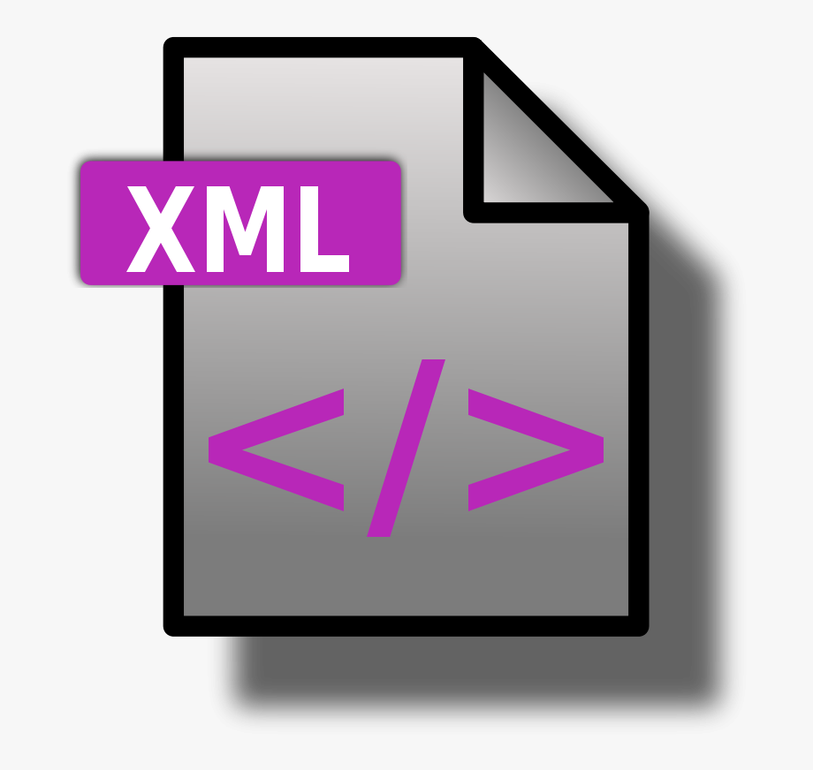
SCL and NSD Files
IEC 61850-7-4
Word or PDF
Logical Node Type
Data Object Type
NSD Files: Name Space Description
Data Attribute Type
Enum Type
SCL Data Type Templates
Code Component

Slide 5
Informal
System Specification
Utility
System Integrator
ICD File
IED Manufacturer
Vendor Data
Types
System Integrator takes
application design decisions and makes
data selection and IEC 61850 mapping
Private Vendor Namespace
SCD File
Vendor
Data
Model
IEC 61850
7-2/3/4
Different solutions for similar Substations/Generation Facilities
No drawings for Application Schemes
Hard to understand for the customer
Nearly impossible to maintain

Slide 6
Utility
SSD/ISD File
System Integrator
Utility takes
application design decisions and makes
data selection and IEC 61850 mapping
Utility
Data
Model
IED Manufacturer
Customized ICD File
Customized
Mappings
Utility
Data
Model
Private Utility Namespace
SCD File
ICD File
Deep IEC 61850 Expertise needed
Vendor Data
Model
IEC 61850
7-2/3/4
Utility Driven
Data Model

Slide 7
Definition
IEC 61850 Namespaces are structured collections of Logical Nodes (LN), Data Objects and potentially Common Data Classes (CDC) and Data Attributes.
They provide the basic building blocks for Data Type Template sections in SCL File.
Namespaces are stored in NSD files (XML).
…and the relevant IEC Standardization document
IEC DTS 61850-1-2 © IEC 2019

Slide 8
Namespace Definition for Utilities
IEC 61850 Basic Namespaces
contain the basic classes from which all other namespaces are built, e.g. IEC 61850-7-2; IEC 61850-7-3; IEC 61850-7-4.
IEC 61850 Domain Namespaces
Namespace which extends IEC 61850 covering a specific application domain. E.g. parts 7-4xx
IEC 61850 Product Namespace
Namespace focussing on Products like Switchgear or IEDs and adding specific information about the product via detailed nameplate information.
IEC 61850 Private Namespace
private data model namespace which extends IEC 61850 with the purpose of better supporting a private implementation(IED vendor) or specification (Utility) of IEC 61850.
IEC 61850 transitional namespace
data model namespace which has the goal to expose a proposed extension of the data model to the market, before being formally embedded into a standard (product, domain or basic) namespace
Source: IEC DTS 61850-1-2 © IEC 2019

Slide 9
Properties of Namespaces
Ownership
A Namespace has an owner who is responsible for the definition and maintenance of the Namespace
Traceability
Objects can indicate on which Namespace they are based on.
Inheritance
Namespaces can be chained together
Rules
Strict rules for the definition and extension of Namespaces prevent owners from jeopardizing interoperability.
Identification
Namespaces are identified by a Name,Version Release and the dependency to other Namespaces
Source: IEC DTS 61850-1-2 © IEC 2019

Slide 10
Rules for the definition of Namespaces
Operation | Rule for Private Namespace Definition
Data Model
Extending existing LNs with new DOs | Allowed following DO naming rules within the scope of the product functions
Create new LNs | Allowed following LN/DO naming rules within the scope of the product functions
Deprecate existing LNs | Allowed only by the owner of the namespace
Extending existing DOs enumeration | Allowed under specific conditions and a specific process
Extending CDC with new attributes (DA) | Forbidden
Create a new CDC | Forbidden
Extending existing DAs enumeration | Forbidden
Making more stringent the DO presence conditions on existing LNs | This DO should be tagged as “namespace specific”
Making less stringent the DO presence conditions on existing LNs | Forbidden
Deprecating DOs from existing LNs | Allowed
Making more stringent the DA presence conditions on existing LNs | In some very specific cases
Making less stringent the DA presence conditions | Forbidden
Defining rules for LN prefix/suffix | Forbidden
Defining rules for LD arrangements | Forbidden
Communication services
Extending the ACSI | Forbidden
Providing a new SCSM | Forbidden
SCL language
Extending the SCL grammar (XSD) with SCL new tags and new attributes | Forbidden
Extending the SCL grammar (XSD) through private sections | Allowed
Extending the SCL grammar (XSD) with tags and new attributes from other xml namespace | Allowed
Source: IEC DTS 61850-1-2 © IEC 2019

Slide 11
Process
Utility Model Manager defines the Private Utility Namespace by
Inheriting Definitions from Base- and Domain Namespaces
Selecting a subset of elements
Extending certain elements
Utilities negotiate Frame Agreements with vendors based on ISD files that are based on the Private Utility Namespace
ISD File
Utility
Data
Model
IEC 61850
7-2/3/4
Private Utility
Namespace
IEC 61850
7-4xx
SSD File
Build up IEC 61850 competence.
Define a Data Model Manager in your organization.
Use IEC 61850 tools for the modeling work.
Embed the Utility Data Model in the company processes.
Utility
Data
Model
Utilities issue System Specifications for Substations or Generation Facilities (SSD files) that are based on the Private Utility Namespace

Slide 12
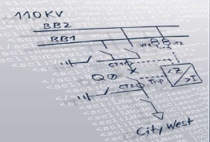
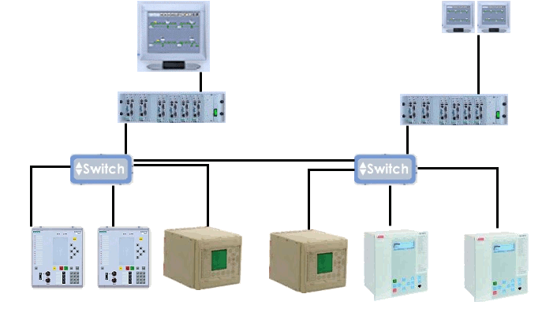
The Benefits of Standardisation
Template Definition
IED
System
Specification
Tool
PDIS
Engineering
Template
IED
Configuration Tool
System
Integration
Tool
Utility driven
Data Model
System Specification
System Integration
System
Specification
Tool
System
Specification
System
Integration
Tool
System
Configuration
Utility driven
Data Model
IED
PDIS
Utility driven
Data Model
IED
Configuration Tool

Slide 13
Conclusion
Utility Namespace
Utilities stay in control of the design of their applications and systems.
Similar Substations/ Generation Facilties have similar designs.
Maintenance is feasible with reasonable effort.
PAC projects can be run more efficiently.
There is no “Free Lunch”. Building up IEC 61850 knowledge requires an effort.
IEC 61850 has a steep learning curve.
Do not shy away from using consultants for initial support

Slide 14
For feedback or questions:
jr@helinks.com
giuseppe.rigadello@enyr.eu

